Slide 1
Encoding & Embedding

Slide 2
Encoding
Assigning numerical values to non-numerical inputs:
One-hot encoding
Term frequency
Term frequency, inverse document frequency
… and more (e.g. SVD)

Slide 3
One-Hot Encoding
No
man
likes
is
salad
an
island
leaves

Slide 4
Term Frequency
an | good | is | island | man | news | no
1 | 0 | 1 | 1 | 1 | 0 | 1
0 | 1 | 1 | 0 | 0 | 2 | 1
Vocabulary
No man is an island
No news is good news
TF: the count of times a term appears in a phrase.
Vocabulary: the set of words in the corpus of text
from sklearn.feature_extraction.text import CountVectorizer

Slide 5
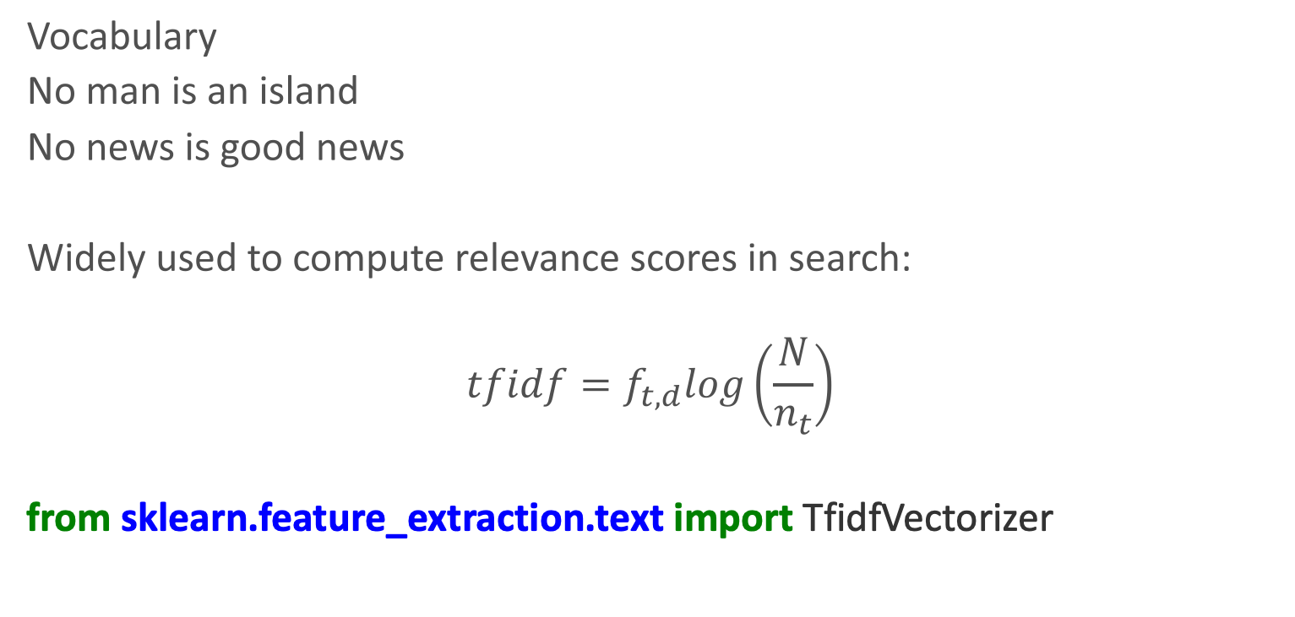
Term Frequency Inverse Document Frequency
an | good | is | island | man | news | no
0.5 | 0 | 0.355 | 0.5 | 0.5 | 0 | 0.355
0 | 0.408 | 0.29 | 0 | 0 | 0.816 | 0.29
Vocabulary
No man is an island
No news is good news
Widely used to compute relevance scores in search:
$$tfidf=f_{t,d}log\left(\frac{N}{n_{t}}\right)$$
from sklearn.feature_extraction.text import TfidfVectorizer

Slide 6
Word Embedding
Mapping of words, phrases and documents to dense vectors of real numbers.
Output is a vocabulary (a set) of such mappings

Slide 7
Vector Space Models
Represent an item (e.g., word) as a Vector of numbers.
banana

Slide 8
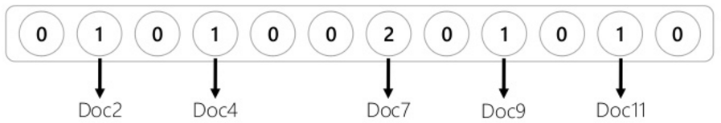
Vector Space Models
Represent an item (e.g., word) as a Vector of numbers.
banana
The vector can correspond to documents in which the word occurs.

Slide 9
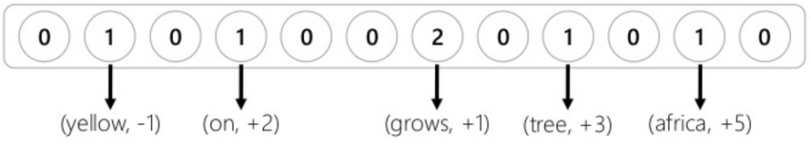
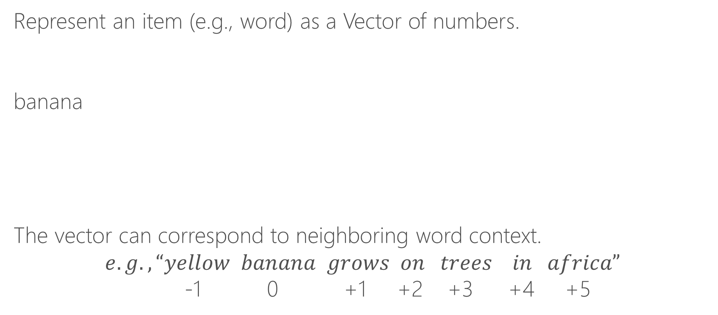
Vector Space Models
Represent an item (e.g., word) as a Vector of numbers.
banana
The vector can correspond to neighboring word context.
$$e.g., “yellow banana grows on trees in africa”$$
-1 0 +1 +2 +3 +4 +5

Slide 10
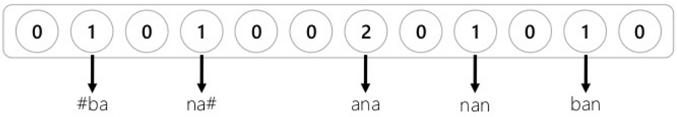
Vector Space Models
Represent an item (e.g., word) as a Vector of numbers.
banana
The vector can correspond to character trigrams in the word.

Slide 11
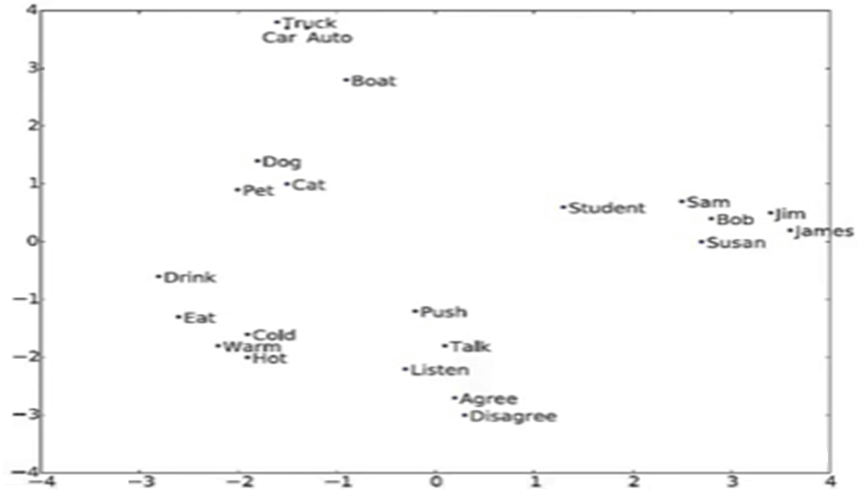
Word Embeddings
<- Word vectors projected by principal components in 2D
Similarity of words implies proximity in vector space
Proximity will depend on representation and distance measure (Euclidean, cosine, Hamming…)

Slide 12
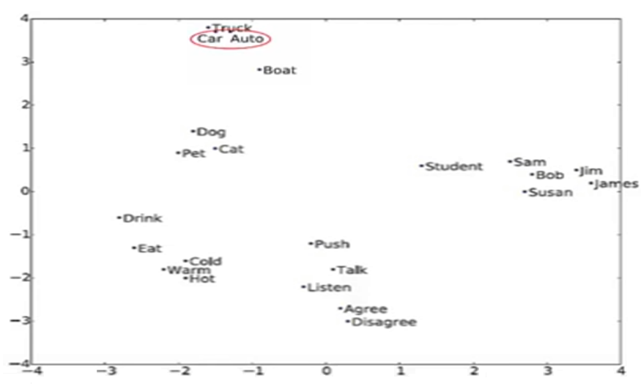
Word Embeddings
Synonym
A word having the same or nearly the same meaning as another word in certain contexts.
Beautiful: Attractive, Pretty, Lovely, Stunning

Slide 13
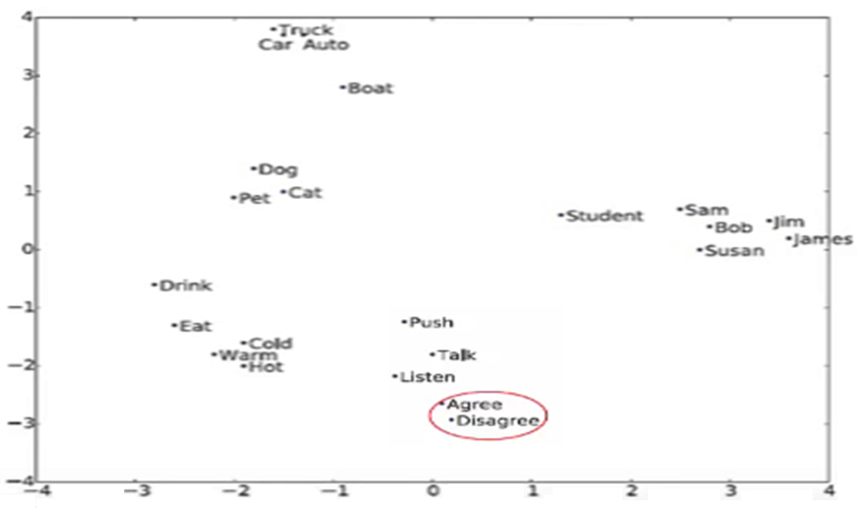
Word Embeddings
Antonym
A word that is opposite in context of another word although similar in other respects.
Afraid – Confident

Slide 14
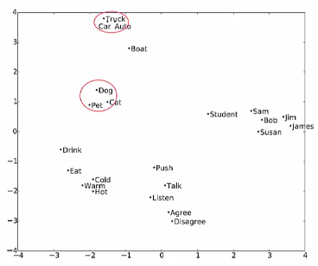
Word Embeddings
Hypernym
A word whose meaning includes the meanings of other words.
Flower is a hypernym of daisy and rose.
Truck is a type of car.

Slide 15
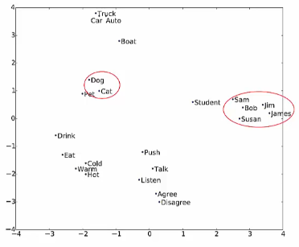
Word Embeddings
Hyponym
A term used to designate a particular member of a broader class.
Cat and rabbit are co-hyponyms of the hypernym animal.

Slide 16
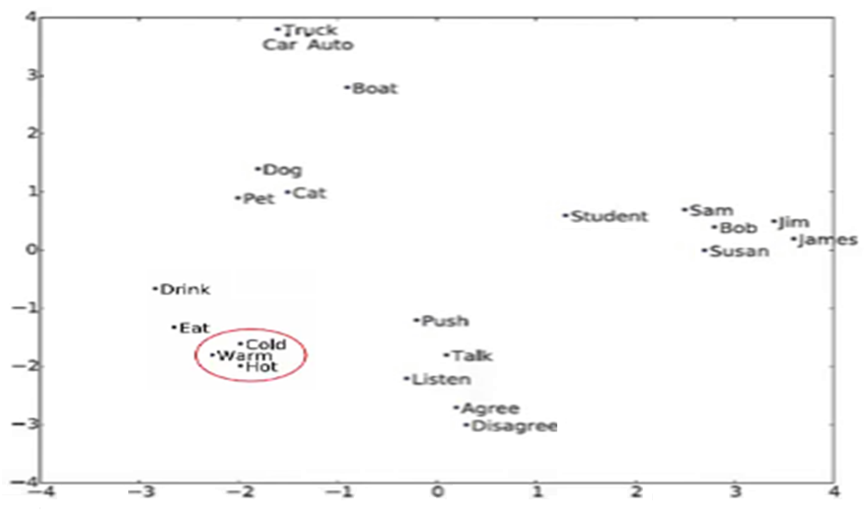
Word Embeddings
Words are values on a scale: hot, warm, cold.

Slide 17
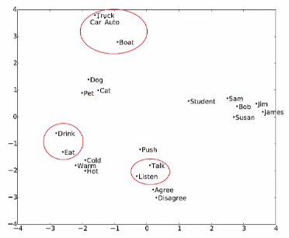
Word Embeddings
Words appear in similar contexts.

Slide 18
Let's Consider The Following Example…
We have four (tiny) documents,
Document 1 : “seattle seahawks jerseys”
Document 2 : “seattle seahawks highlights”
Document 3 : “denver broncos jerseys”
Document 4 : “denver broncos highlights”

Slide 19
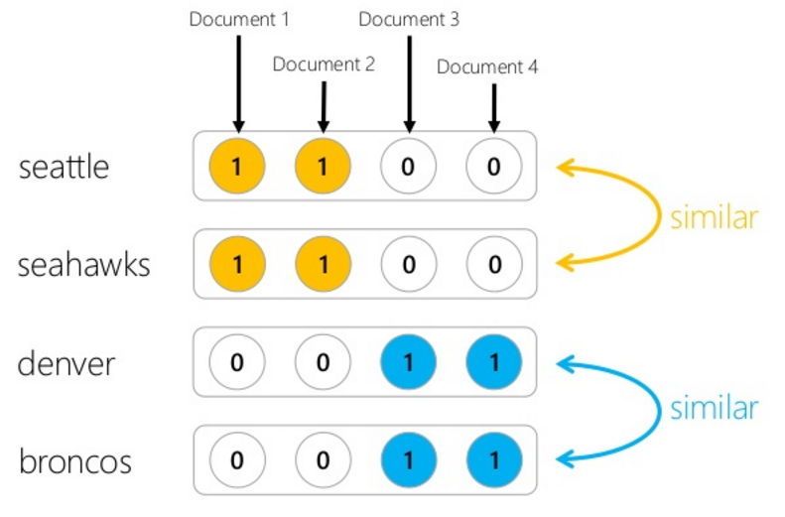
If We Use Document Occurrence Vectors...

Slide 20
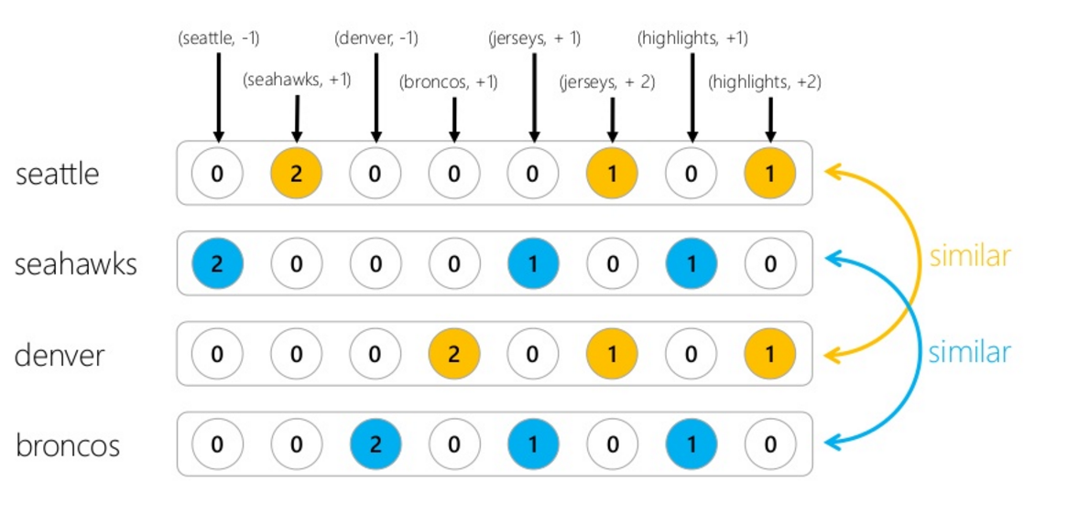
If We Use Word Context Vectors...

Slide 21
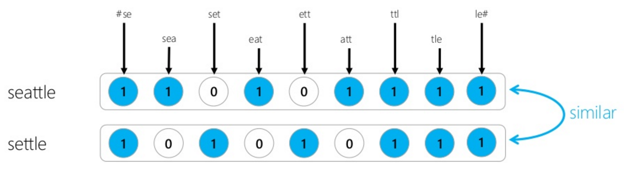
If We Use Character Trigrams Vectors...
This notion of relatedness is similar to string-edit distance.

Slide 22
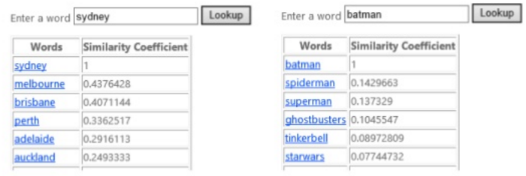
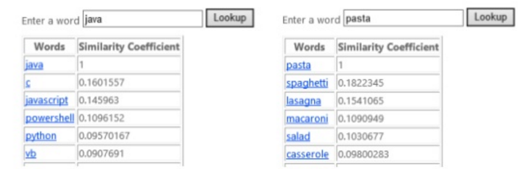
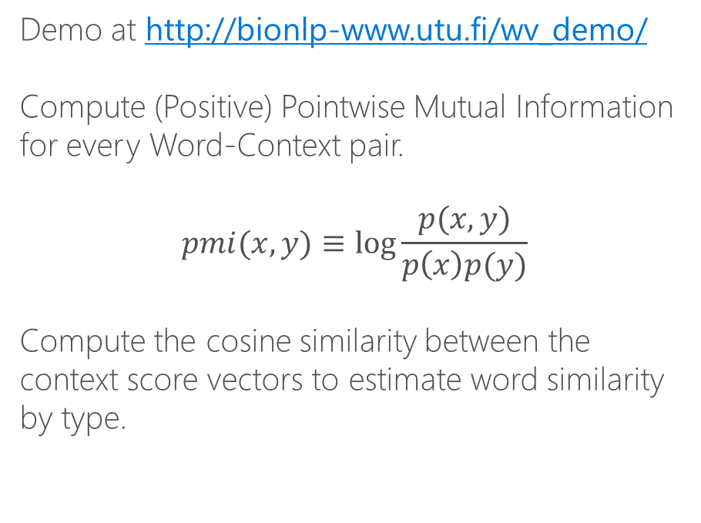
DIY: Learning Word Types
Demo at http://bionlp-www.utu.fi/wv_demo/
Compute (Positive) Pointwise Mutual Information for every Word-Context pair.
$$pmi(x,y)≡\log{\frac{p(x,y)}{p\left(x\right)p(y)}}$$
Compute the cosine similarity between the context score vectors to estimate word similarity by type.

Slide 23
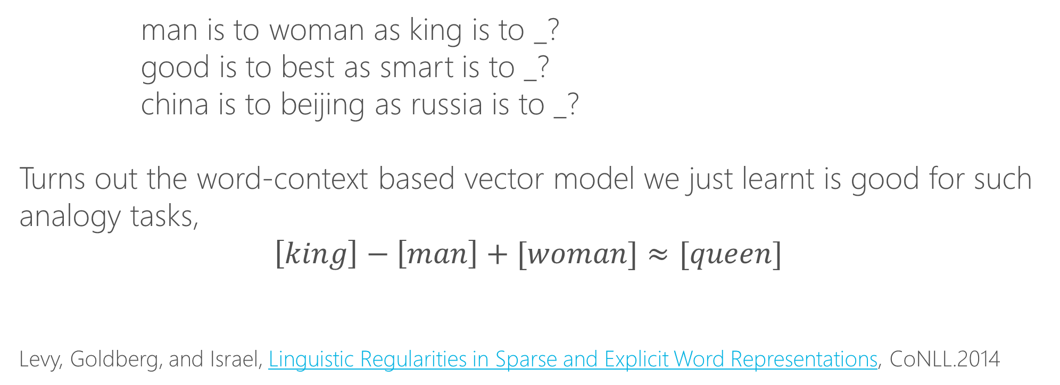
Word Analogy Task
man is to woman as king is to _?
good is to best as smart is to _?
china is to beijing as russia is to _?
Turns out the word-context based vector model we just learnt is good for such analogy tasks,
$$\left[king\right]−\left[man\right]+[woman]≈[queen]$$
Levy, Goldberg, and Israel, Linguistic Regularities in Sparse and Explicit Word Representations, CoNLL.2014

Slide 24
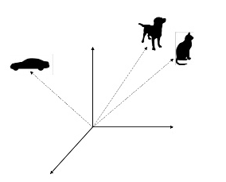
Embeddings
The vectors we have been discussing so far are very high-dimensional (thousands, or even millions) and sparse.
But there are techniques to learn lower-dimensional dense vectors for words using the same intuitions.
These dense vectors are called embeddings.

Slide 25
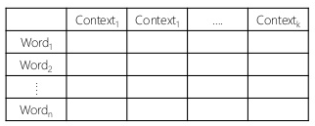
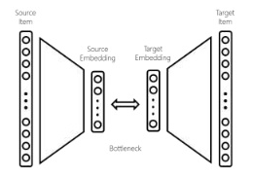
Learning Dense Embeddings
Matrix Factorization
Factorize word-context matrix.
E.g.,
LDA (Word-Document),
GloVe (Word-NeighboringWord)
Neural Networks
A neural network with a bottleneck, word and context as input and output respectively.
E.g.,
Word2vec (Word-Neighboringword)
Deerwester, Dumais, Landauer, Furnas, and Harshman, Indexing by latent semantic analysis, JASIS,1990.
Pennington, Socher, and Manning, GloVe: Global Vectors for Word Representation, EMNLP, 2014. Mikolov, Sutskever, Chen, Corrado, and Dean, Distributed resentations of Words and phrases and their compositionality, NIPS, 2013.

Slide 26
Word2Vec
A set of 2-layer networks that perform the mapping
Continuous Bag of Words (CBOW) networks predict current word from a context of 5 (default) surrounding words.
Order is not important
Continuous skip-gram uses the current word to predict the context (10 words by default).
Closer words weigh more heavily

Slide 27
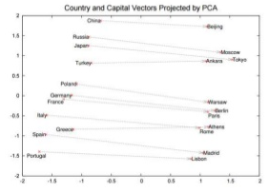
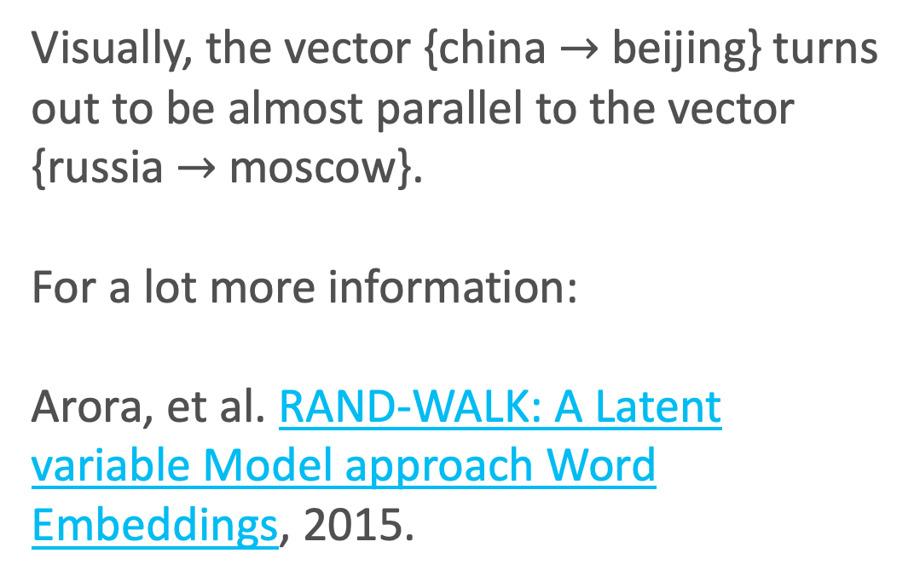
How Do Word Analogies Work?
Visually, the vector {china $→$beijing} turns out to be almost parallel to the vector {russia $→$moscow}.
For a lot more information:
Arora, et al. RAND-WALK: A Latent variable Model approach Word Embeddings, 2015.
Mikolov, Sutskever, Chen, Corrado, and Dean, Distributed representations of words and phrasses and their compositionality, NIPS, 2013.

Slide 28
What’s Next?
Train your own or use a pre-trained embedding
Word2vec
Word2vec trained on queries
GloVe

Slide 29
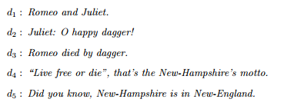
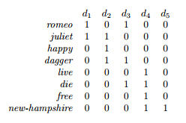
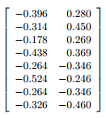
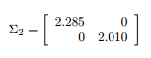
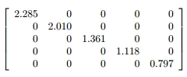
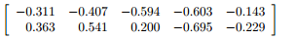
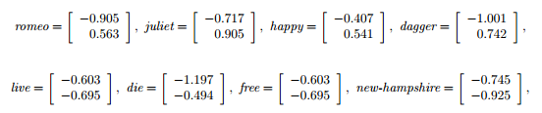
A =
A ≅ U_{k}𝚺_{k}V_{k}ᵀ
Embedding by Matrix Factorization
A = U𝚺Vᵀ
U₂ =
𝚺₂ =
𝚺 =
V_{k}ᵀ =
Courtesy: http://webhome.cs.uvic.ca/~thomo/svd.pdf
Notes:
B=AtA (document-document matrix)
C=Aat (term-term matrix)
A=SsigmaUt where S is the matrix of eigenvectors of B, U of C and sigma is a diagonal matrix of singular values aka square roots of eigenvalues of B

